Slide 1



On the relationship between the fractal dimension of geomagnetic variations and the solar wind speed
15th Quadrennial Solar-Terrestrial Physics (STP-15) symposium
STP15-ABS-233
Gvozdarev Alexey
Gorno-Altaysk State University

Slide 2
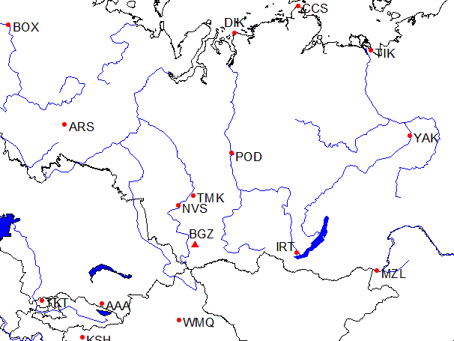
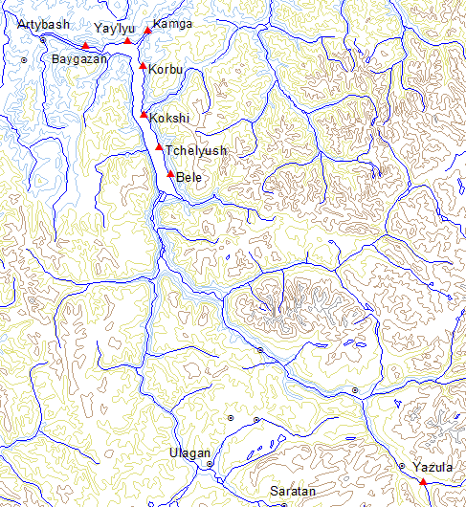
A magnetic station Baygazan (BGZ) is located between 4 INTERMAGNET’s magnetic observatory (NVS – Novosibirsk, IRT – Irkutsk, AAA – Alma-Ata, WMQ – Urumchi) at Altayskiy State Nature Biospheric Reserve territory. It allows to record magnetical variations with small magnetical noise and to compare geomagnetical field dynamics at several points.
The station is located at distance 15 km of Artybash on north shore of Teletskoe lake (cordon Baygazan). The range of geomagnetical field at distance of 1 km from the station is not exceeded 550 nT (58870-59410 nT at 2009).
BGZ

Slide 3
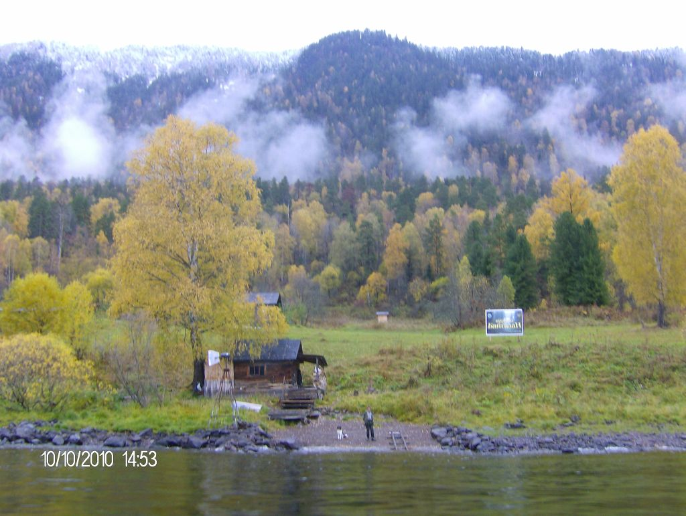
Inspector home
Variation hut

Slide 4
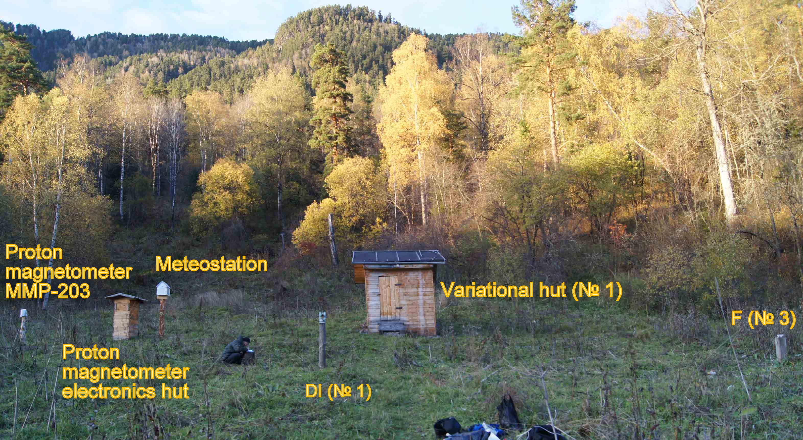
INT-1 coil magnetometer site
General view of the magnetic station Baygazan
DI – pillar for absolute DI measurements;
F – pillar for POS-1 total vector measurement

Slide 5
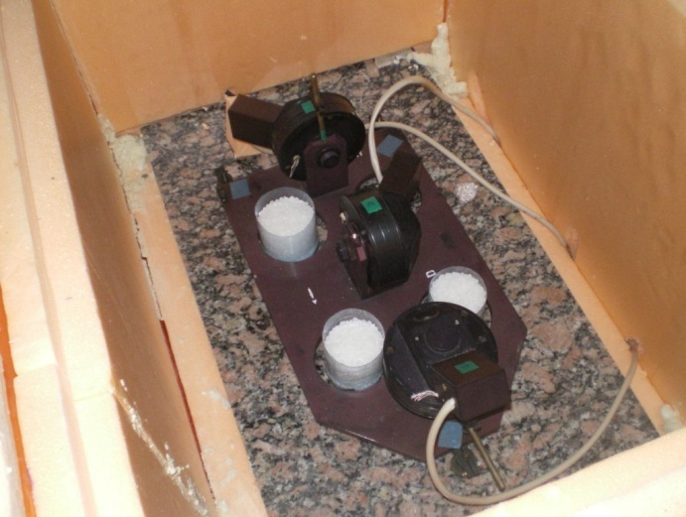
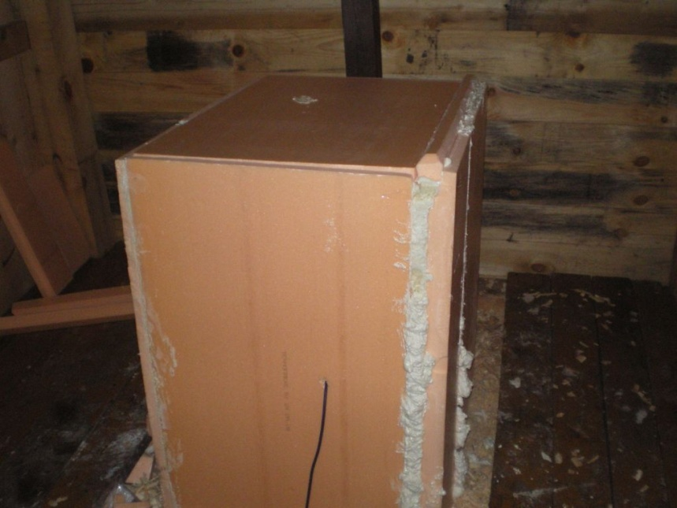
Variometer: Quartz-3EM
Measurements start: 03/12/2009
Geomagnetic field components: D, H, Z
Measurement rate: 5 Hz, 20 Hz
Noise level (standart deviation of 5 measurements):
3-10 pT
SD card volume: 2 Gb, 8 Gb (for about 6 month record)
GPS synchronization: one per day, 1μs accuracy
Temperature measurement accuracy: 0.1˚C
Number of missing measurements: about 400 per day
Power consumption: 2W
Passive thermal stabilization: expanded polystyrene (20 cm)
Temperature range: -18˚C - +20˚C
Basement: lime-stone base (1×1×1m), glass blocks and granite slab
Magnetic field gradient: 0.8 nT/m
Variation hut: 3.8×2.5 m, wood, copper nails, ondulin
Variometer: Quartz-3EM with dizitizer
designed at Robionics Laboratory of GASU

Slide 6
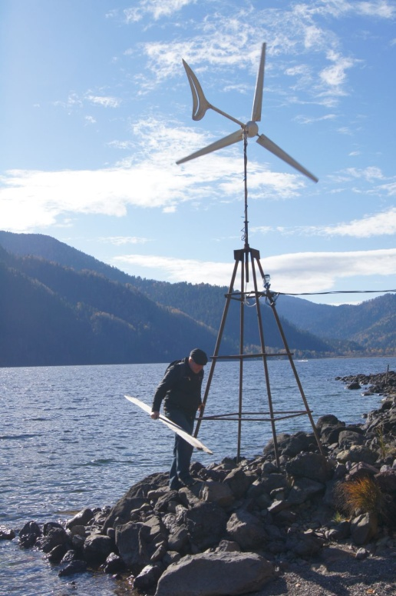
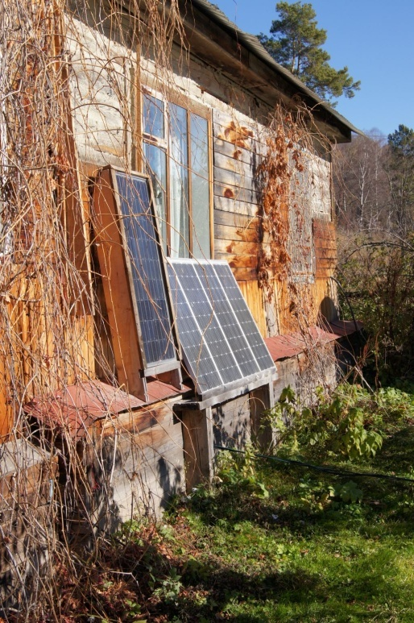
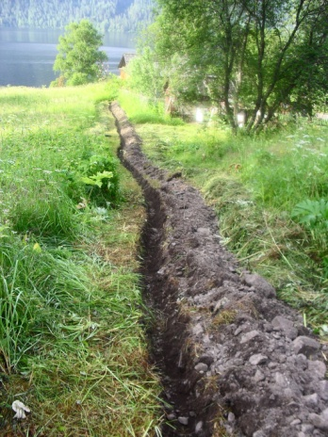
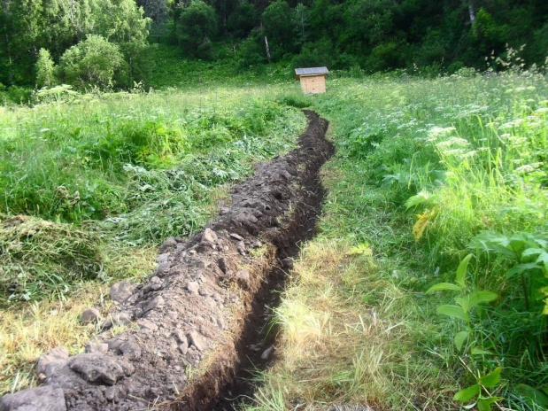
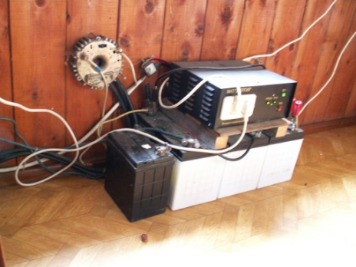
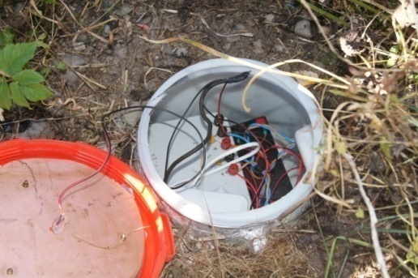
Energy system
- Solar batteries with peak power 230 W
- Wind generator with peak power 300 W
- Gel battery 240 A-hour
- Charge controller “MAP Energy” 1500 W
- Inverter (‘pure sine’) 300 W
- Cable line in metal-plastic tube: length 130 m, depth 0.15m.
- Low noise power supply with 2 independent voltage sources 12 V (for digital/analog devices) at plastic box at distance 8 m from variation hut
Separated grounding point for digital/analog devices (resistance 100 Ohm)
Power consumption 27 W.
1.5 F capacitor for proton magnetometer polarization
Wind generator
Solar batteries
Charge controller
“MAP Energy”
Power supply 2×12V

Slide 7
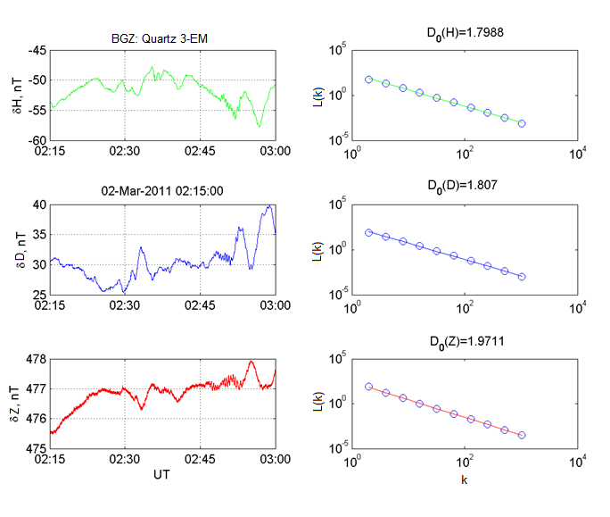


Higuchi method
Distance between row elements X(i) i=1…N, m=1…k, X=H,D,Z, N=810 000 (45 min)
(periods of geomagnetic variation T=0.4-205 c)
This distance is averaged over all m
D- fractal dimension
Gotoh, K., Hayakawa, M., Smirnova, N. Fractal analysis of the ULF geomagnetic data obtained at Izu Peninsula, Japan in relation to the nearby earthquake swarm of June-August 2000 // Natural Hazards and Earth System Science. - 2003. – Vol. 3, No 3-4. - P. 229-236.

Slide 8
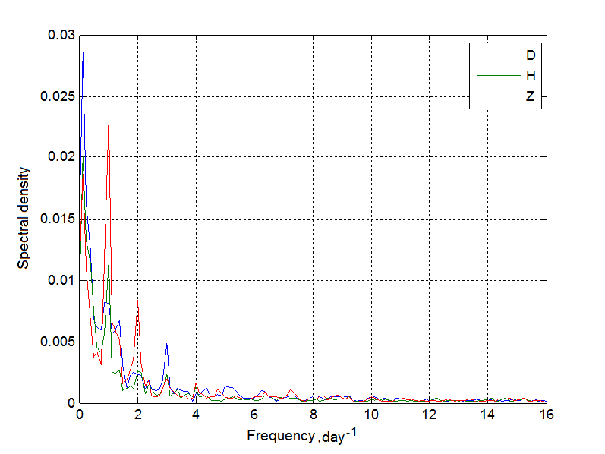
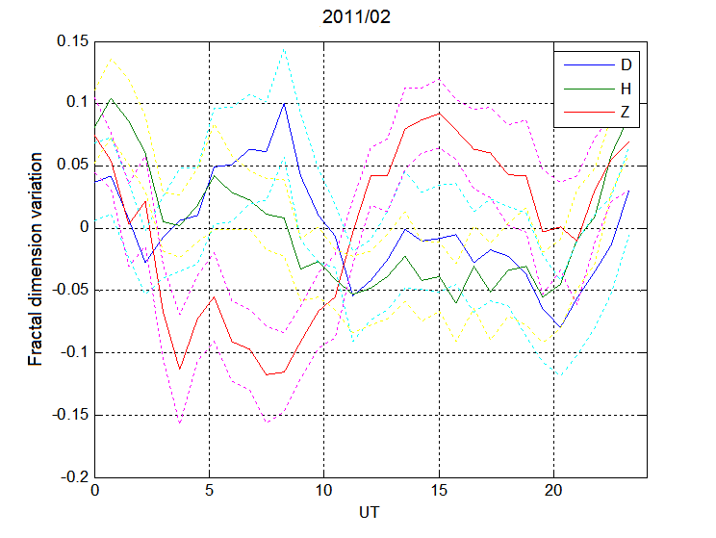
15th Quadrennial Solar-Terrestrial Physics (STP-15) symposium: STP15-ABS-233
Variations of fractal dimension of geomagnetic field
Diurnal variation of geomagnetic field fractal dimension at Altay (average monthly deviation from the smoothed curve for Feb-2011). The dotted curves show a confidence intervals (р=0.95)
Spectrum of fractal dimension variations according to February 2011 data

Slide 9
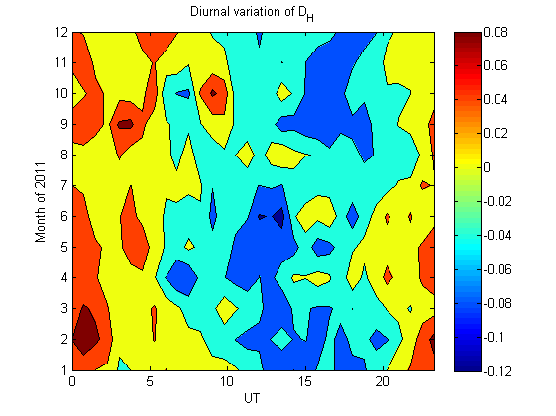
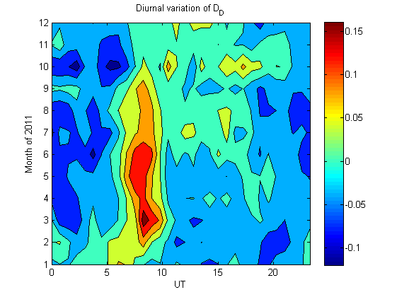
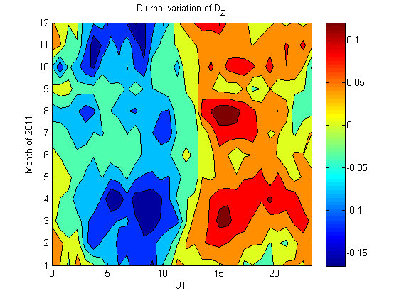

15th Quadrennial Solar-Terrestrial Physics (STP-15) symposium: STP15-ABS-233
Daily-seasonal dependence of geomagnetical variation fractal dimension
at Altay. Isolines step is 0.04
average of fractal dimension

Slide 10
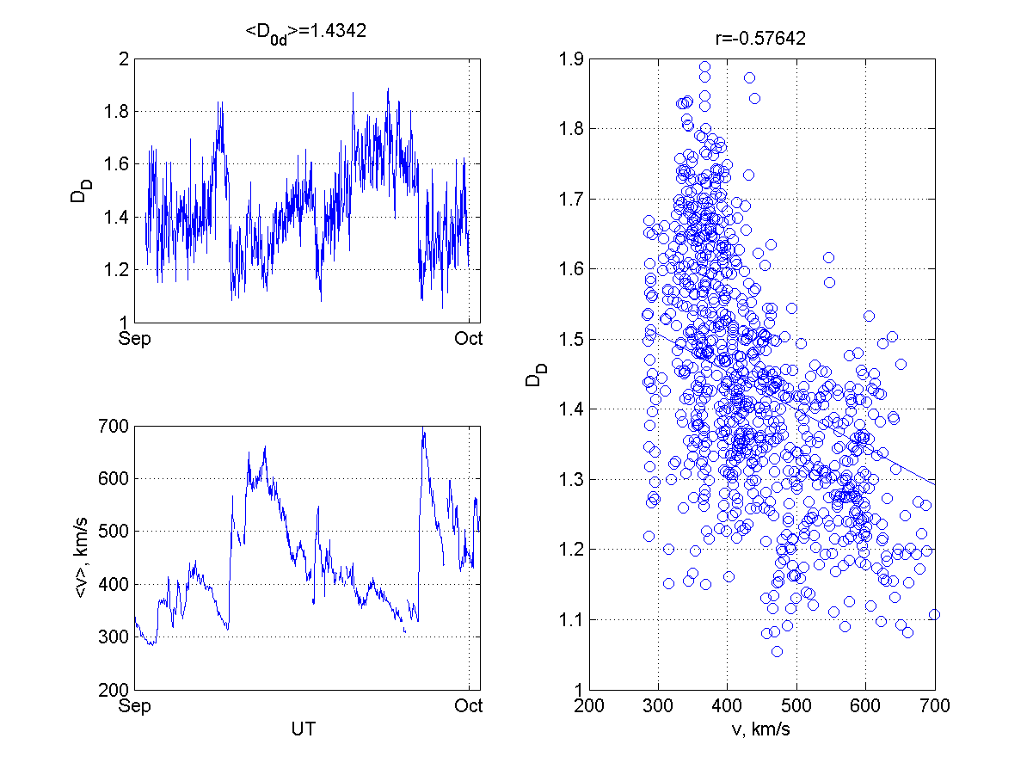
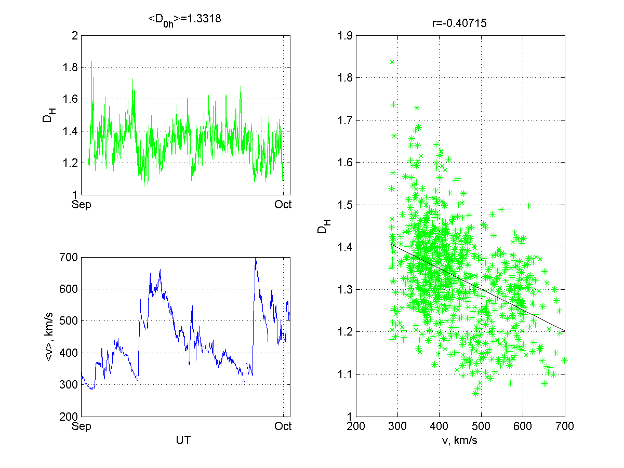
15th Quadrennial Solar-Terrestrial Physics (STP-15) symposium: STP15-ABS-233
Then, the diurnal variation of fractal dimension was removed from the data,
and the correlation coefficients with a mean values of the solar wind velocity (omniweb.gsfc.nasa.gov) over 45 minutes were calculated.
The correlation coefficient for fractal dimension of geomagnetical field component and solar wind velocity in 2011
D(H) | D(D) | D(Z)
-0.41 | -0.51 | -0.52
Dependence of fractal dimension of D- (left) H-component (right) at Altay on solar wind velocity for Sept 2011. Correlation coefficient is shown at right panel title.

Slide 11
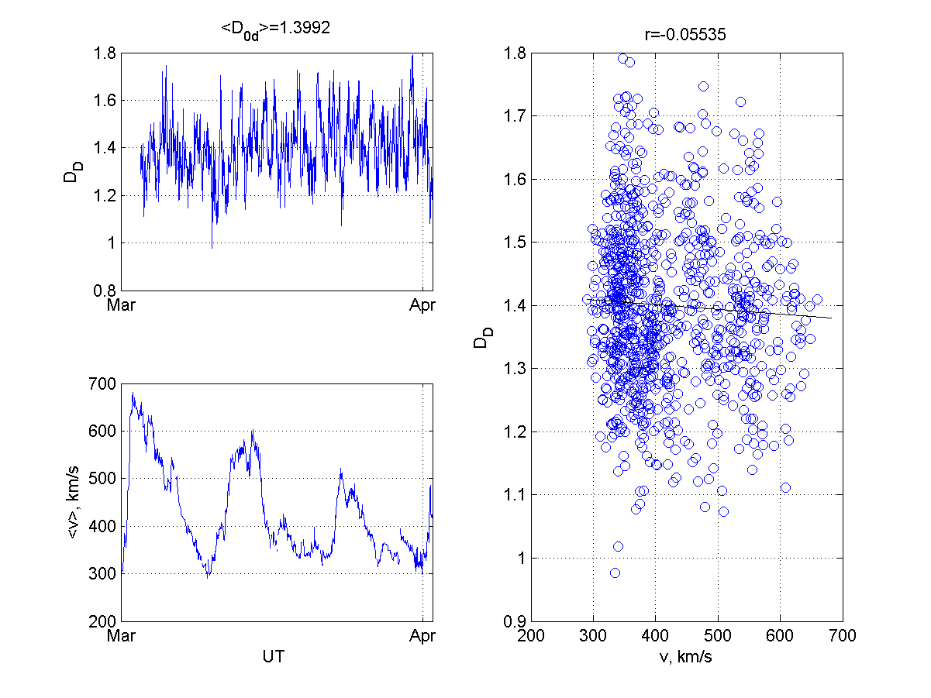
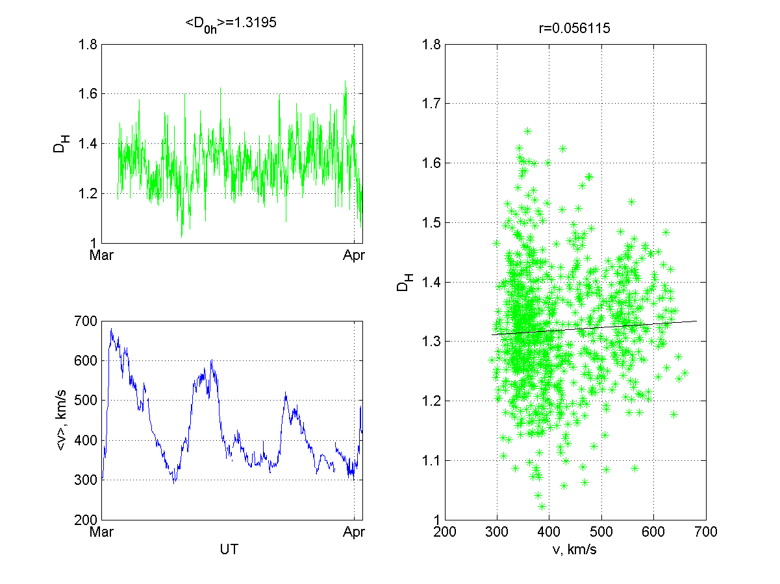
15th Quadrennial Solar-Terrestrial Physics (STP-15) symposium: STP15-ABS-233
Dependence of fractal dimension of D- (left) and H-component (right) at Altay on solar wind velocity for March 2011. Correlation coefficient is shown at right panel title. It is shown, that correlation is absent.
Other sources of plasma turbulense?

Slide 12
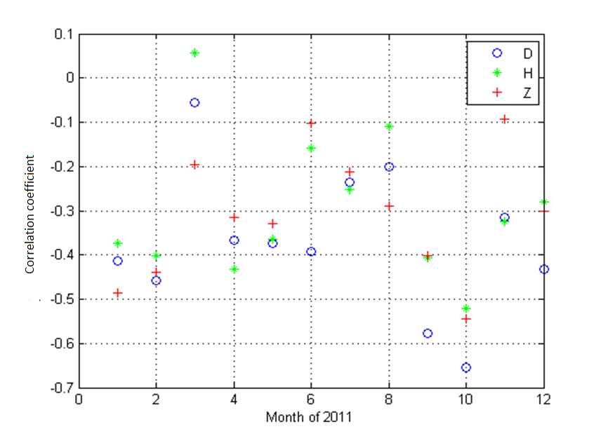
15th Quadrennial Solar-Terrestrial Physics (STP-15) symposium: STP15-ABS-233
Monthly correlation coefficients for geomagnetical variation fractal dimension at Altay and solar wind velocity

Slide 13
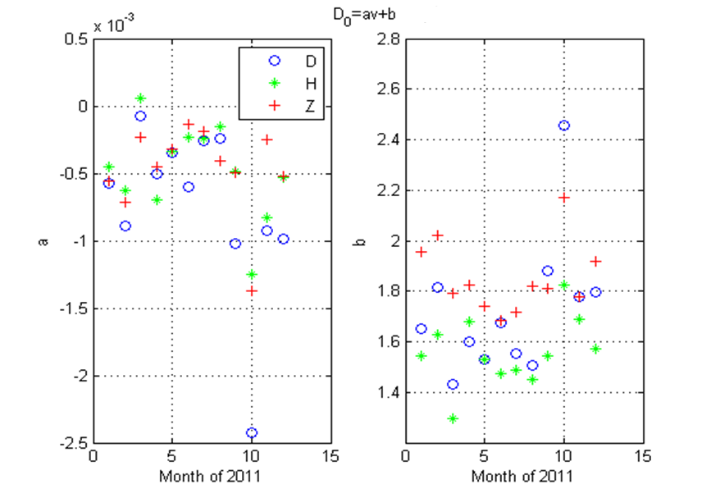
15th Quadrennial Solar-Terrestrial Physics (STP-15) symposium: STP15-ABS-233
Monthly regression coefficients for geomagnetical variation fractal dimension at Altay and solar wind velocity

Slide 14
15th Quadrennial Solar-Terrestrial Physics (STP-15) symposium: STP15-ABS-233
Conclusion
For each 45-minute interval for Baygazan quartz variometer data of 2011, the fractal dimensions of DHZ-geomagnetic variations were calculated using the Higuchi method (9918 values).
The diurnal variation of fractal dimension was removed from this values, and the correlation coefficients with the mean values of the solar wind velocity over 45 minutes were calculated. The negative correlation of geomagnetic variation fractal dimension and averaged solar wind velocity is revealed.
Probably, the speed of the solar wind affects a turbulence of a magnetospheric plasma and this is reflected in the fractal dimension of geomagnetic variations
The more detailed analysis have shown that the correlation coefficients vary from month to month =>. Are there inner atmosphere sources of plasma turbulence in ionosphere?

Slide 15
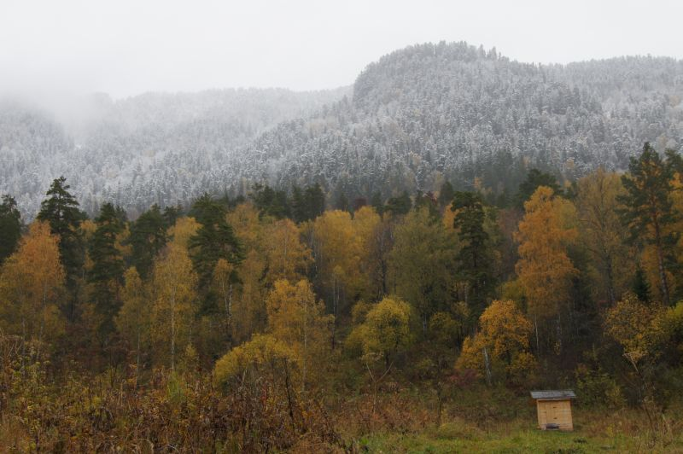
Thank you for attention!
This work is supported by RFBR grant 20-45-040013 r_а

